Slide 1
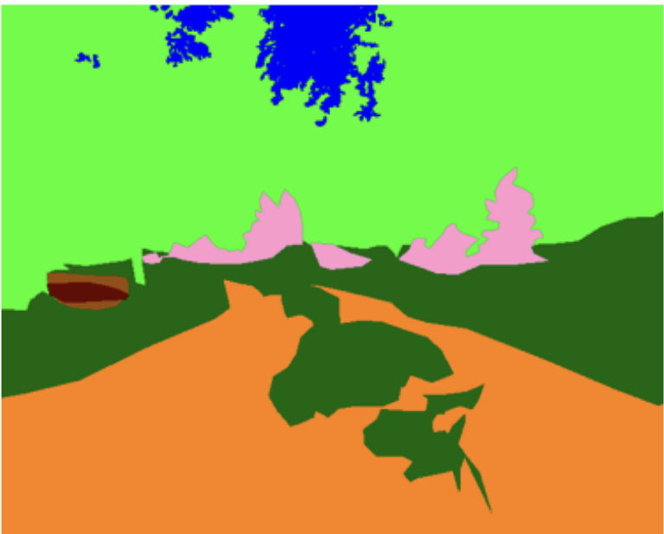
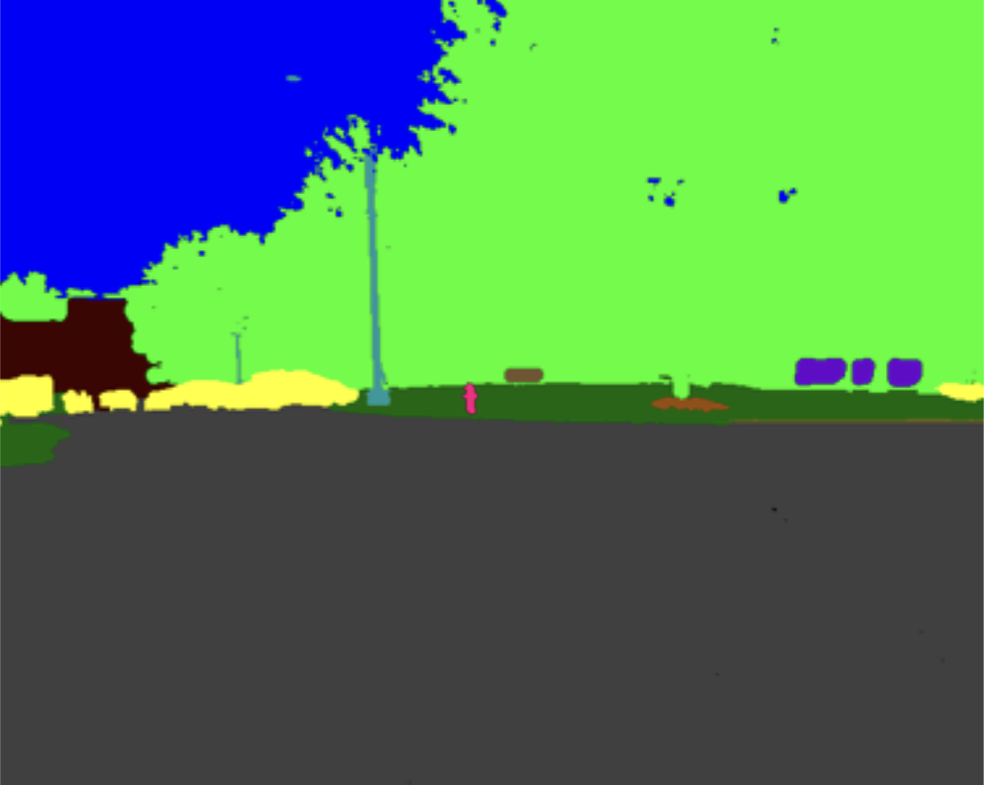
Semantic Segmentation in Unstructured Environments
DeepMinders
Man Ching Melvin Chan (z5361805)
Jonas Macken (z5208799)
Zirui Wang (z5464720)
Dimas Putra Anugerah (z5520430)
Aryan Wadhawan (z5444107)

Slide 2
Problem Statement
Presenter: Zirui Wang
The aim of this study is to…
Repurpose existing encoder-decoder Convolutional Neural Networks used for image segmentation tasks for the RUGD dataset. Through data augmentation and additional neural network modules, investigate the impacts of these techniques on addressing the challenges of the RUGD.

Slide 3
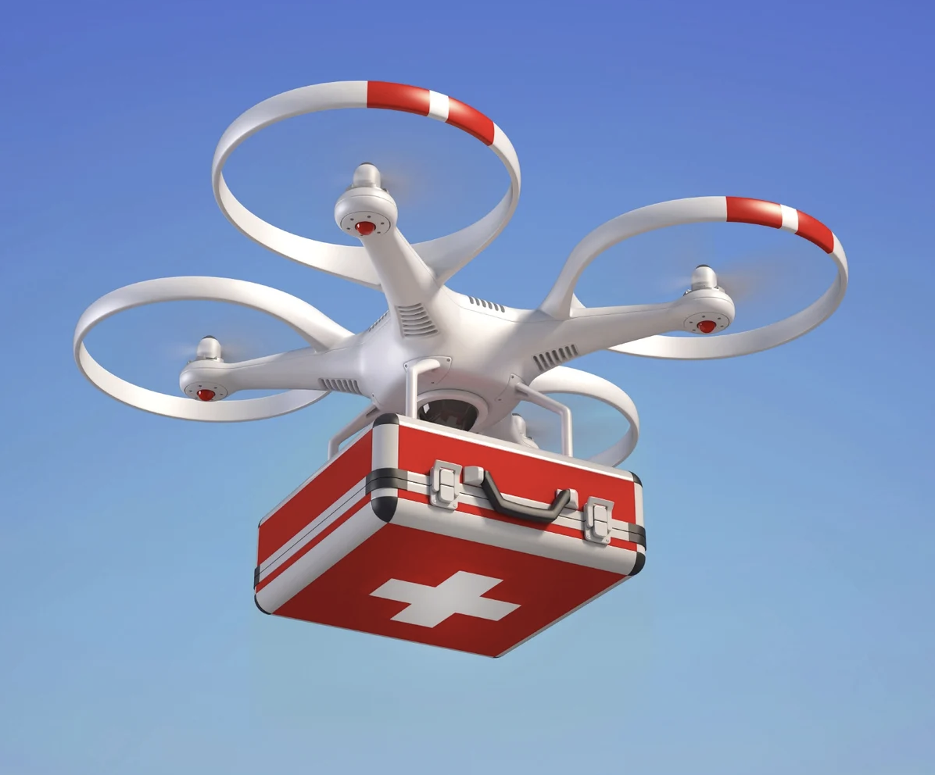
Motivation
Presenter: Zirui Wang
Image Segmentation (Identifying which image pixels belong to an object): An important task in Computer Vision
Applications of image segmentation in autonomous drones:
Humanitarian aid and disaster relief
Agricultural tasks
Environmental surveying in challenging conditions
Used by organizations like the UN:
Unmanned Aerial Vehicles (UAVs) deliver medical supplies in disaster zones.
Challenge: Limited operational range of UAVs.
Potential of autonomous robots:
Navigate independently to locate survivors and provide timely aid.
[1] United Nations World Food Programme. 2020. Using drones to deliver critical humanitarian aid. https://drones.wfp.org/updates/using-drones-deliver-critical-humanitarian-aid

Slide 4
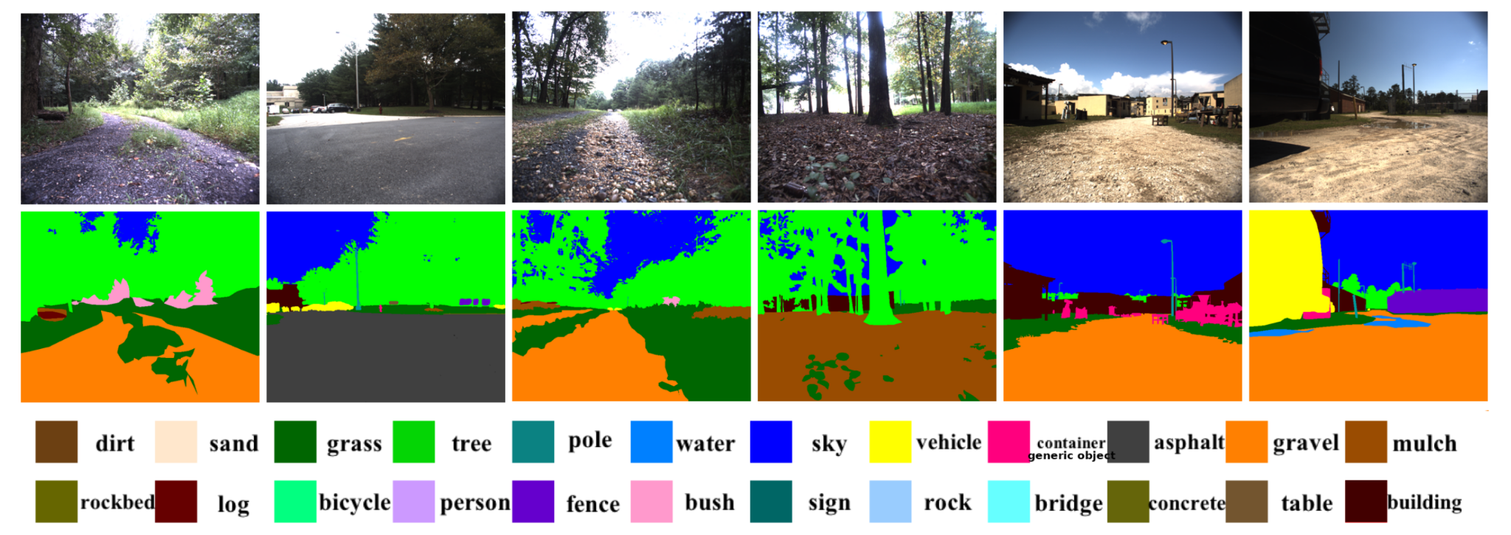
Dataset: Robot Unstructured Ground Driving (RUGD)
Presenter: Dimas Anugerah
Physical characteristics
A series of videos were recorded on rugged terrain with the following properties:
15 frames per second
The camera was 25cm off of the ground
1376 x 1110 resolution
From these videos which contained 25 classes for image segmentation, every 5th frame of the video was taken as data for the RUGD dataset. The dataset contains 7,456 frames scaled down to a size of 688 x 555 px.
RUGD dataset with annotated masks and reference to all 25 classes [1] (the null class is not included in this figure).
[2] Wigness, Maggie and Eum, Sungmin and Rogers, John G and Han, David and Kwon, Heesung. 2019. RUGD: Robot Unstructured Ground Driving: A Video Dataset for Visual Perception and Autonomous Navigation in Unstructured Environments. International Conference on Intelligent Robots and Systems (IROS). http://rugd.vision/

Slide 5
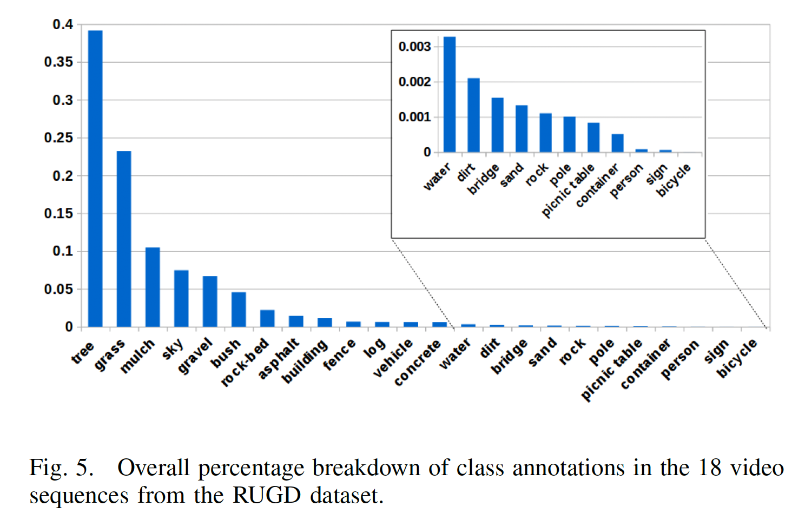
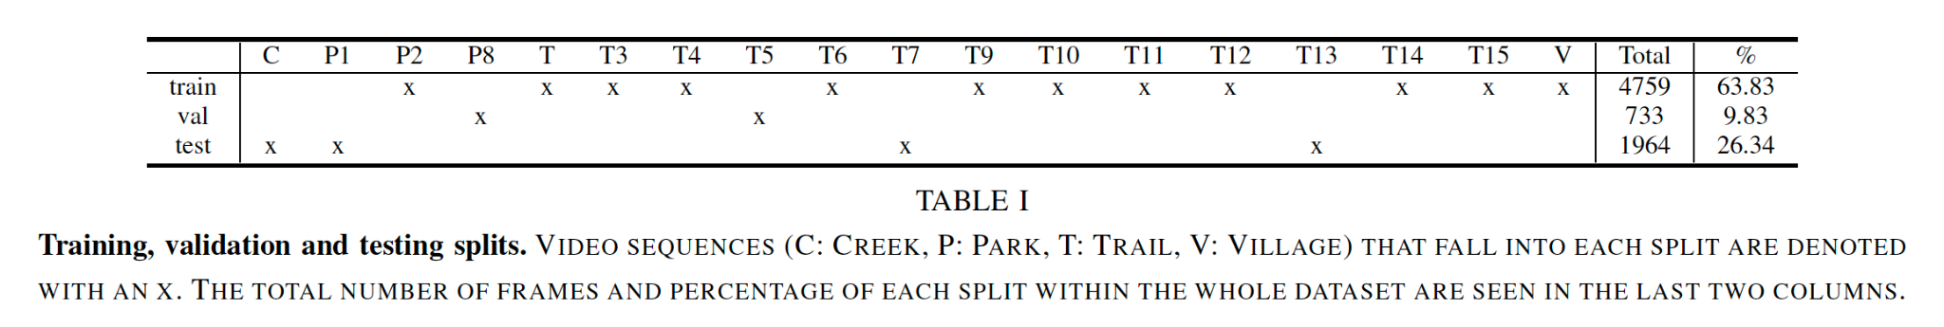
Dataset: Robot Unstructured Ground Driving (RUGD)
Presenter: Dimas Anugerah
Class Annotations Distribution
[3] Wigness, Maggie and Eum, Sungmin and Rogers, John G and Han, David and Kwon, Heesung. 2019. RUGD: Robot Unstructured Ground Driving: A Video Dataset for Visual Perception and Autonomous Navigation in Unstructured Environments. International Conference on Intelligent Robots and Systems (IROS). http://rugd.vision/

Slide 6
Dataset: Robot Unstructured Ground Driving (RUGD)
Presenter: Dimas Anugerah
Comparison with existing datasets
Other existing video benchmark datasets are either
Urban environments with structured road markings and predictable segmentation classes (CityScapes, Deepdrive)
Annotated only on binary traversibiliy classes
Comparatively, the RUGD dataset were recorded on unstructured, unmarked terrains. These features presents challenges that conventional models cannot solve
Blurred frames: The majority of scenes contain no discernible geometric edges or vanishing points
Irregular boundaries: 8 distinct terrains are traversed (dirt, grass, sand, water, rockbed, gravel, mulch, and asphalt) which has no regular separation points
Illumination changes: From the harsh shadows of outdoor environment
Novel terrains: The creek class is only included in the testing dataset to assess the model’s capacity to classify unseen terrain

Slide 7
RUGD Paper
Presenter: Man Ching
A RUGD Dataset for Autonomous Navigation and Visual Perception in Unstructured Outdoor Environments [1] - Points of Interest
This paper introduces the traditional encoder-decoder networks used for urban environments in the context of the RUGD dataset. These will be introduced in subsequent slides
Mean IOU Accuracy: This represents the Mean Intersection-over-Union (Mean IoU) accuracy. The IoU for each class is computed as
Mean IoU is obtained by averaging the IoUs over all 25 semantic classes.
Pixel Accuracy: Percentage of correctly classified pixels across all classes
Mean Pixel Accuracy: Percentage of correctly classified classes, averaged across the 25 semantic categories
True Positive
True Positive + False Positives + True Negatives
[4] Wigness, Maggie and Eum, Sungmin and Rogers, John G and Han, David and Kwon, Heesung. 2019. RUGD: Robot Unstructured Ground Driving: A Video Dataset for Visual Perception and Autonomous Navigation in Unstructured Environments. International Conference on Intelligent Robots and Systems (IROS). http://rugd.vision/

Slide 8
Methods
Presenter: Aryan Wadhawan
General
Optimization Strategies for Best Baseline Model:
Hyperparameter Tuning: (LR, decay, batch size, momentum)
Architecture Enhancement: (Add ASPP module)
Data Augmentation: (Flipping, rotation)
Class Rebalancing:
GANs
Crop & resize rare regions
CutMix (sticker approach)
Class-aware loss weighting
All strategies were tested on U-Net over 4 epochs with fixed parameters and a seed for consistent, comparable results.

Slide 9
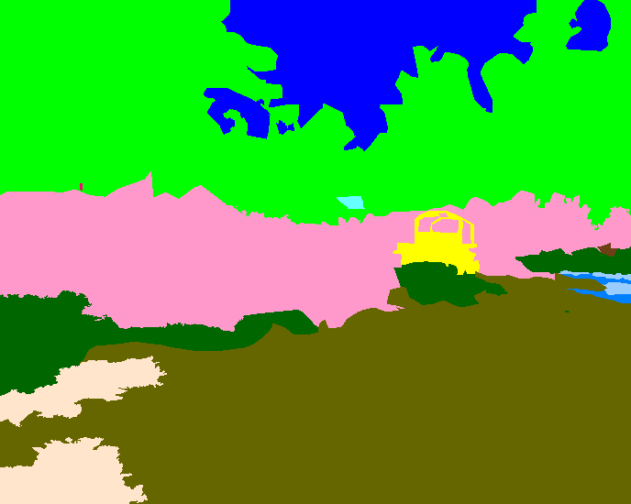
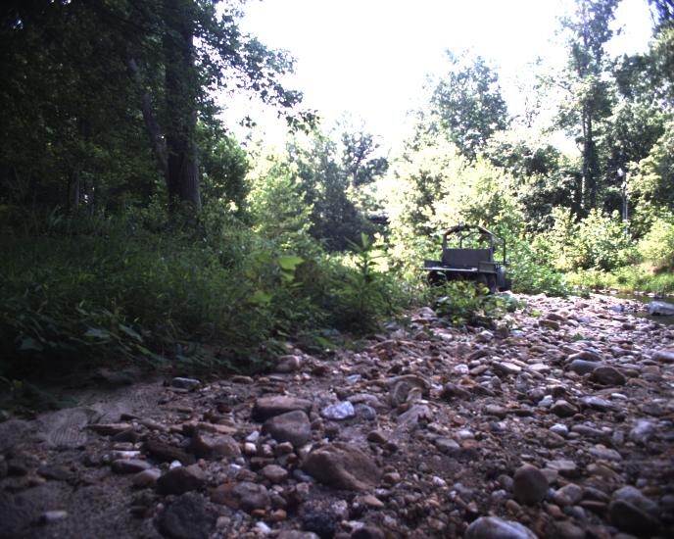
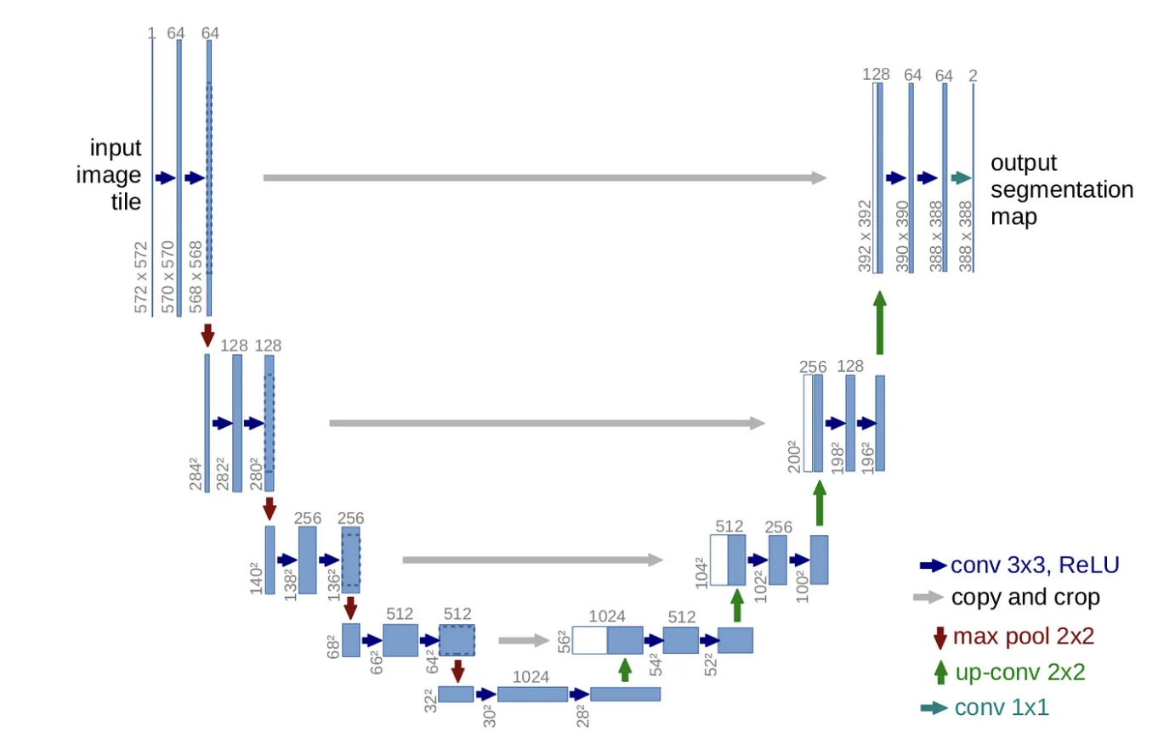
Baseline Models - UNet with ResNet50 backbone
Presenter: Jonas Macken
Model Architecture
Fully convolutional
Endoder / decoder blocks
Uses skip connections to pass information from the encoder to the decoder blocks directly
Skip connections help model retain spatial information, crucial for unstructured outdoor environments
ResNet50 provides robust pre-trained feature extraction
U-Net Architecture [4]
[6] Alejandro Ito Aramendia. 2024. The U-Net: A Complete Guide. Medium. https://medium.com/@alejandro.itoaramendia/decoding-the-u-net-a-complete-guide-810b1c6d56d8

Slide 10
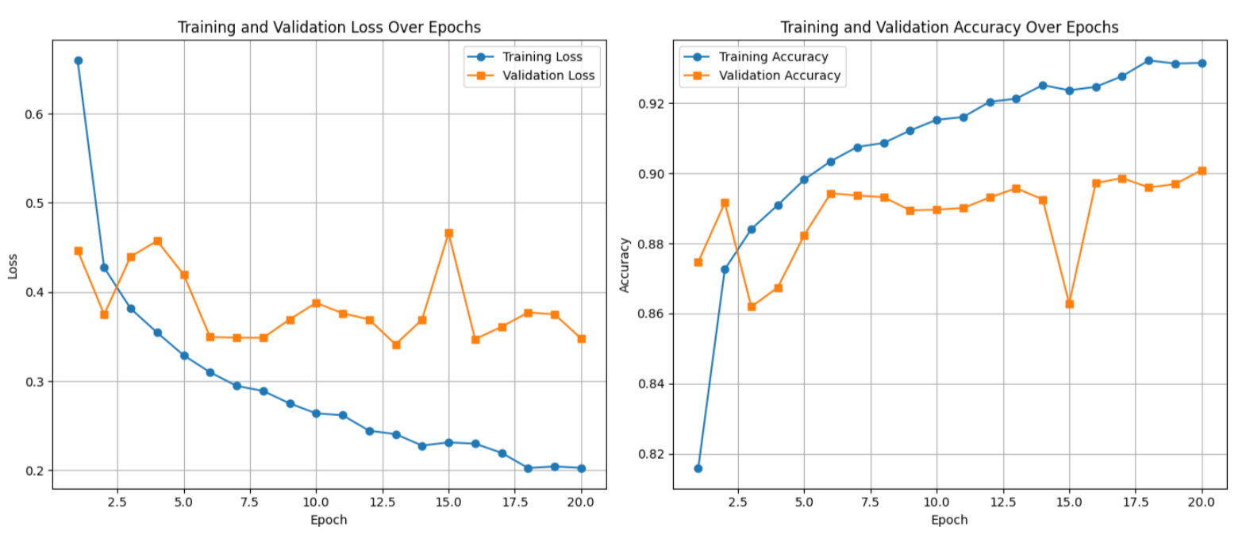
Baseline Models - UNet with ResNet50 backbone
Presenter: Jonas Macken
Results
Models | Mean IOU (%) |  | Pixel Accuracy (%) |  | Mean Pixel Accuracy (%)
 | Validation | Test | Validation | Test | Validation | Test
ResNet50 + UNet | 17.28 | 13.93 | 90.09 | 73.70 | 20.20 | 17.26

Slide 11
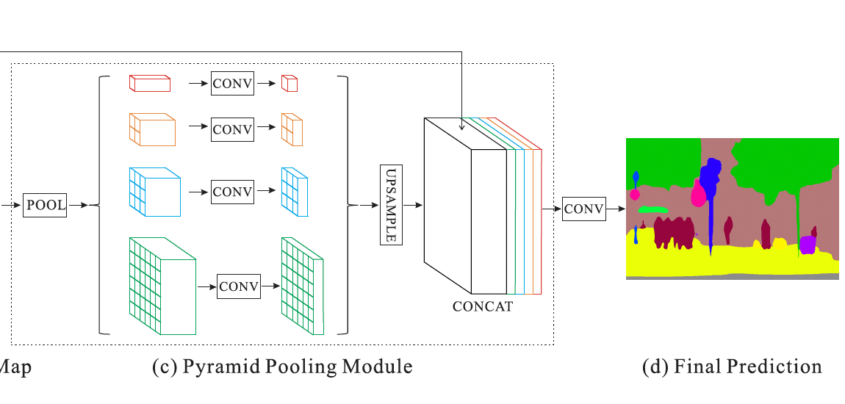
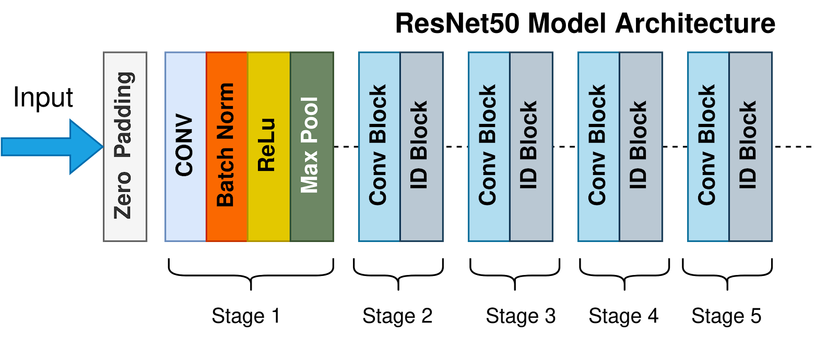
Baseline Models - PSPNet with ResNet50 backbone
Presenter: Dimas Anugerah
ResNet50 encoder with dilated convolution + PSPNet decoder
The Pyramid Scence Parsing (PSP) decoder uses a pyramidal pooling module, which takes 4 convolutional layer and combines them with an average pooling module. This is then upsampled to the correct output size.
Adds a global context information to improve pixel-level accuracy
Dilated Convolution: Gaps equal to the dilation rate is taken between each stride during the convolution step. This allows the model to get a wider context of what is happening in the image.
Example ResNet50 [5] + PSPNet Architecture [6]
[7] Suvaditya Mukherjee. 2022. The Annotated ResNet-50. Medium. https://towardsdatascience.com/the-annotated-resnet-50-a6c536034758
[8] Hengshuang Zhao, Jianping Shi, Xiaojuan Qi, Xiaogang Wang, and Jiaya Jia. Pyramid Scene Parsing Network. CVPR 2017.

Slide 12
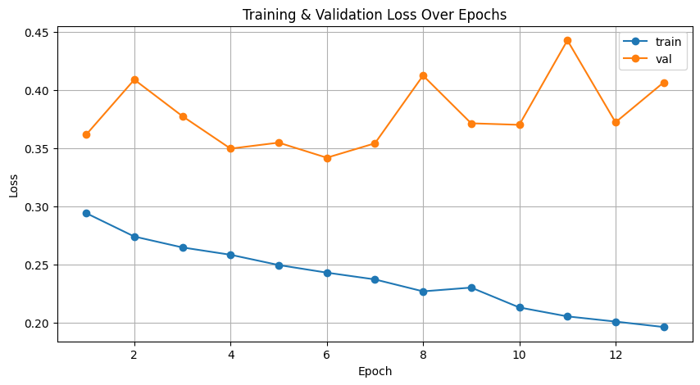
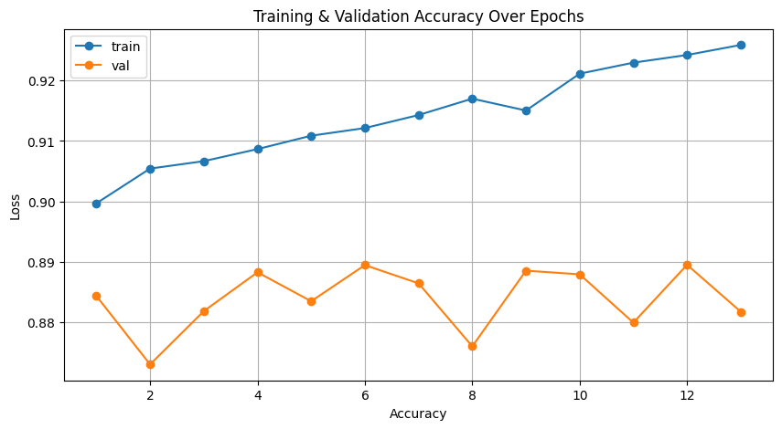
Baseline Models - PSPNet with ResNet50 backbone
Presenter: Dimas Anugerah
Results
Models | Mean IOU (%) |  | Pixel Accuracy (%) |  | Mean Pixel Accuracy (%)
 | Validation | Test | Validation | Test | Validation | Test
ResNet50 + PSPNet | 15.43 | 13.62 | 88.95 | 72.78 | 17.99 | 16.58

Slide 13
Baseline Models - ResNet50 encoder with dilated convolutions + PSPNet decoder with deep supervision
Presenter: Man Ching
Model Architecture
ResNet encoder is the same as previous models
Added deep supervision to increase the information flow from encoder to decoder as auxiliary outputs
Deep supervision example from UNet architecture

Slide 14
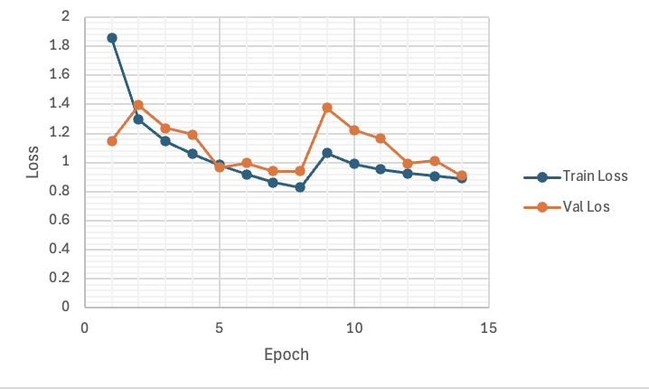
Baseline Models - ResNet50 encoder with dilated convolutions + PSPNet decoder with deep supervision
Presenter: Man Ching
Results
Models | Mean IOU (%) |  | Pixel Accuracy (%) |  | Mean Pixel Accuracy (%)
 | Validation | Test | Validation | Test | Validation | Test
ResNet50 Dilated Convolution + PSPNet with Deep Supervision | 33.2% | 13.59% | 85.7% | 68.89% | 15.22% | 13.59%
Test performance drops off significantly.

Slide 15
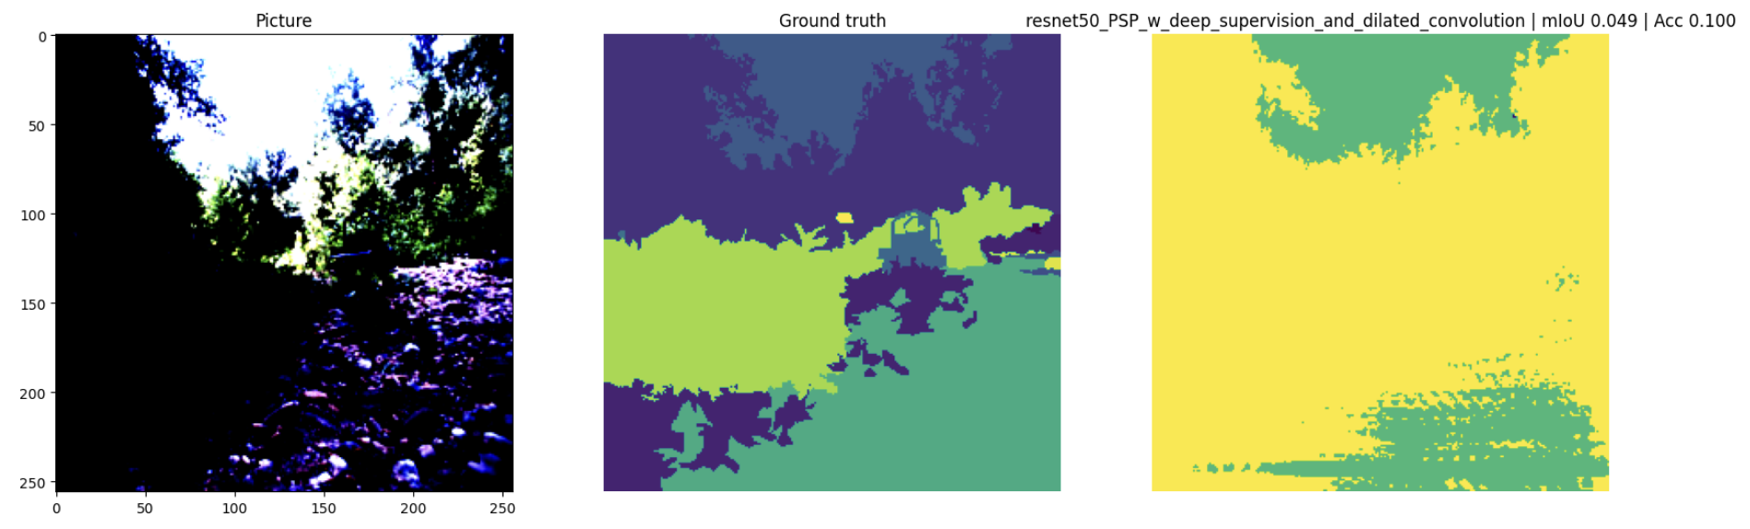
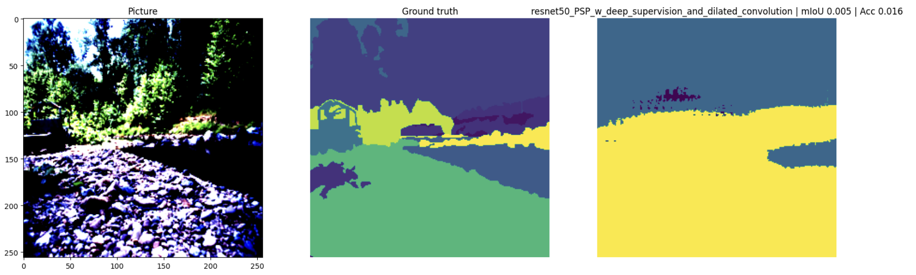
Baseline Models - ResNet50 encoder with dilated convolutions + PSPNet decoder with deep supervision
Presenter: Man Ching
Results
Only binary classifications
Cannot handle complex configurations of borders
High MIOU compared to other models: it identifying the background and foreground at the right borders but does not identify the features

Slide 16
Baseline Models
Presenter: Zirui Wang
Results compared with RUGD dataset paper (Validation set top, Test set bottom)
Models | Mean IOU (%) |  | Pixel Accuracy (%) |  | Mean Pixel Accuracy (%)
 | Paper | Baseline | Paper | Baseline | Paper | Baseline
1) ResNet50 + UNet | - | 17.28 | - | 90.09 | - | 20.20
2) ResNet50 + PSPNet | 36.27 | 15.43 | 90.05 | 88.95 | 53.27 | 17.99
3) ResNet50 + PSPNet with Dilated Convolution and Deep Supervision | 36.67 | 33.2% | 90.36 | 85.7% | 52.06 | 15.22%
Models | Mean IOU (%) |  | Pixel Accuracy (%) |  | Mean Pixel Accuracy (%)
 | Paper | Baseline | Paper | Baseline | Paper | Baseline
1) ResNet50 + UNet | - | 14.65 | - | 73.81 | - | 17.87
2) ResNet50 + PSPNet | 32.07 | 13.62 | 75.74 | 72.78 | 52.14 | 16.58
3) ResNet50 + PSPNet with Dilated Convolution and Deep Supervision | 31.78 | 10.86% | 75.03 | 68.89% | 52.96 | 13.59%

Slide 17
Hyper Parameter Tuning
Presenter: Man Ching
Hyper parameter tuning was investigated to optimise accuracy of baseline models
Hyper Parameter training focused on finetuning 4 parameters,
Learning rate
Batch number
Momentum
Weight decay
Original parameters were taken from the RUGD paper and are as follows:
Learning rate: 0.01
Batch number: 8
Momentum: 0.9
Weight decay: 0.001

Slide 18
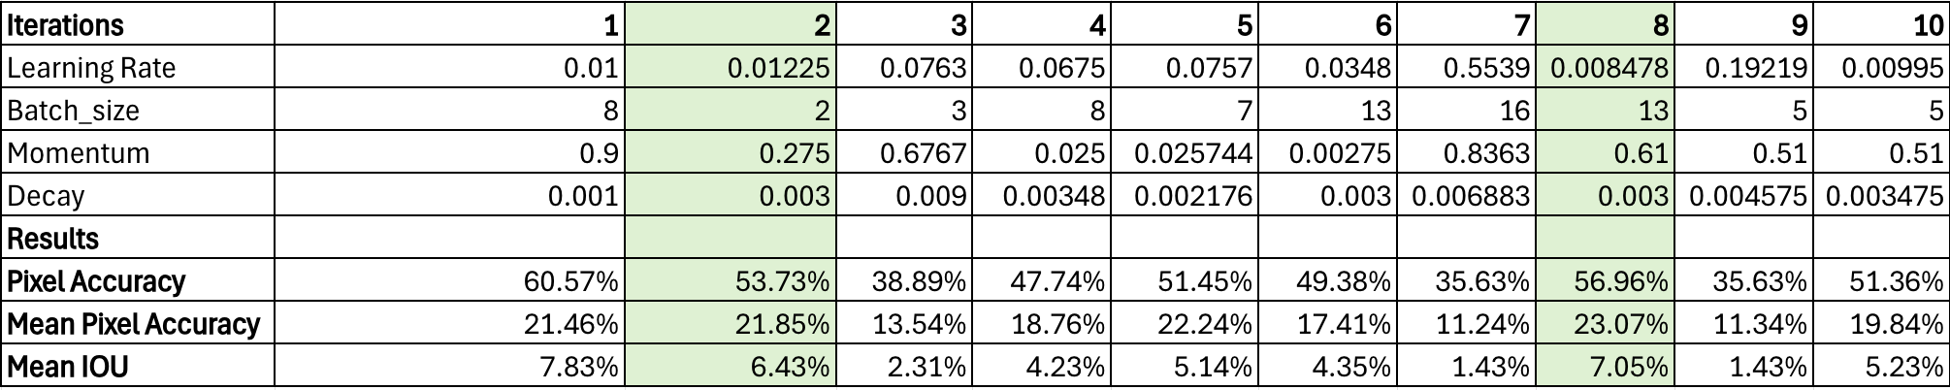
Hyper Parameter Tuning
Presenter: Man Ching
Random search was used to fine tune selective hyper parameters
Random search was used to establish baseline trends to see how the hyper parameters can be adjusted for optimisation. The first 10 iterations were shown below, and the outcome showed that iterations were more optimised with
Higher weight decay
Lower learning rate
Lower momentum
Iteration results from random search

Slide 19
Hyper Parameter Tuning
Presenter: Man Ching
Final results
The new hyper parameters are
Learning rate: 0.002
Batch number: 10
Momentum: 0.7
Weight decay: 0.003
 | Pixel Accuracy | Mean Pixel Accuracy | Mean IOU
Baseline | 60.57 % | 21.46% | 7.83%
Optimised hyper parameters | 66.62% | 25.01% | 8.85%

Slide 20
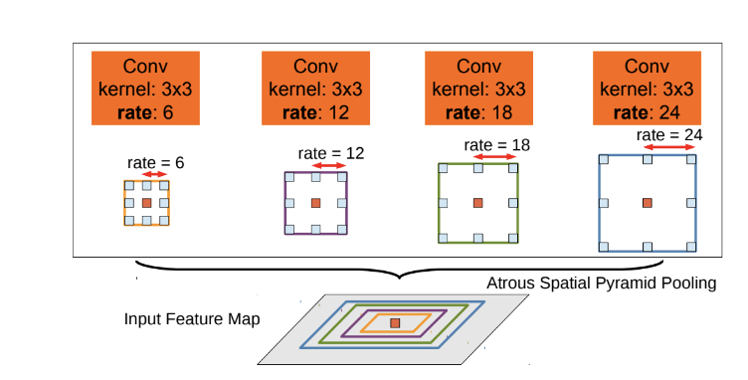
Results - ASPP Modules
Presenter: Man Ching
ASPP is a pooled pyramidal module for dilated convolution
ASPP module takes multiple instances of dilated convolutional layers from the input feature map and combines them as an input for the next layer. This allows the encoder to recognise features at a larger contextual level.
Visualisation of ASPP module [7]
[9] Liang-Chieh Chen, George Papandreou, Iasonas Kokkinos, Kevin Murphy, Alan L. Yuille. 2016. DeepLab: Semantic Image Segmentation with Deep Convolutional Nets, Atrous Convolution, and Fully Connected CRFs. https://paperswithcode.com/paper/deeplab-semantic-image-segmentation-with-deep

Slide 21
Results - ASPP Modules
Presenter: Man Ching
ASPP applied at different intensities to UNet model with better mean pixel accuracy results
Found that 4 convolutional layers for the ASPP module provided the best optimisation for the UNet model. This was compared based on the testing data
 | Mean IOU | Pixel Accuracy | Mean Pixel Accuracy
Baseline | 13.82% | 73.69% | 23.88%
3 convolutional components | 12.17% | 71.45% | 27.07%
4 convolutional components | 13.14% | 74.55% | 28.21%
5 convolutional components | 12.28% | 74.11% | 27.10%

Slide 22
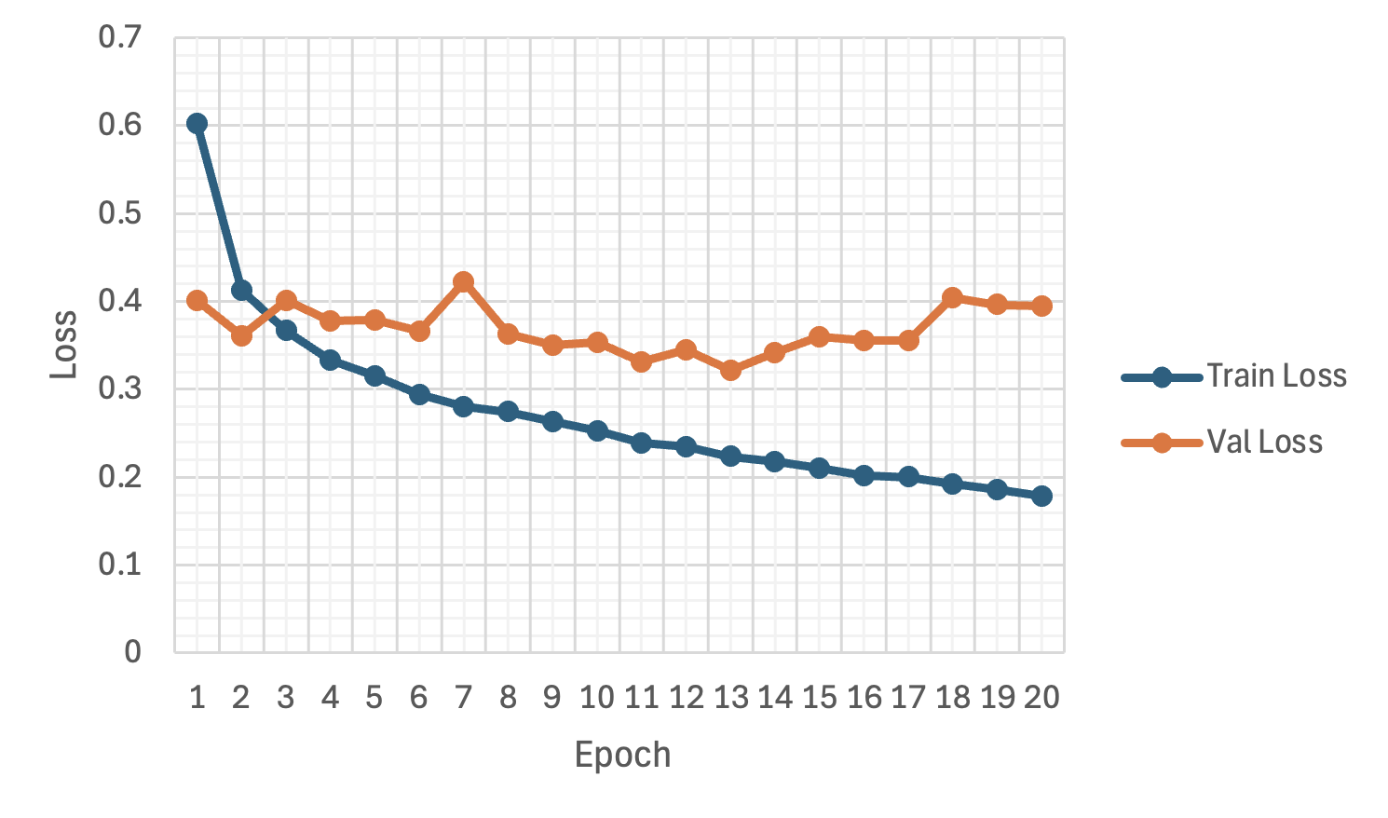
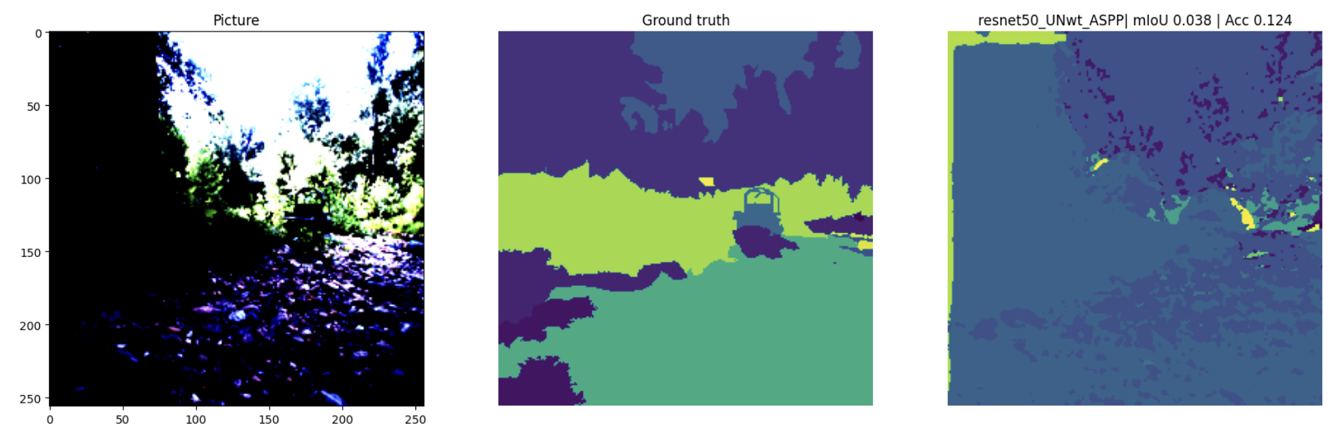
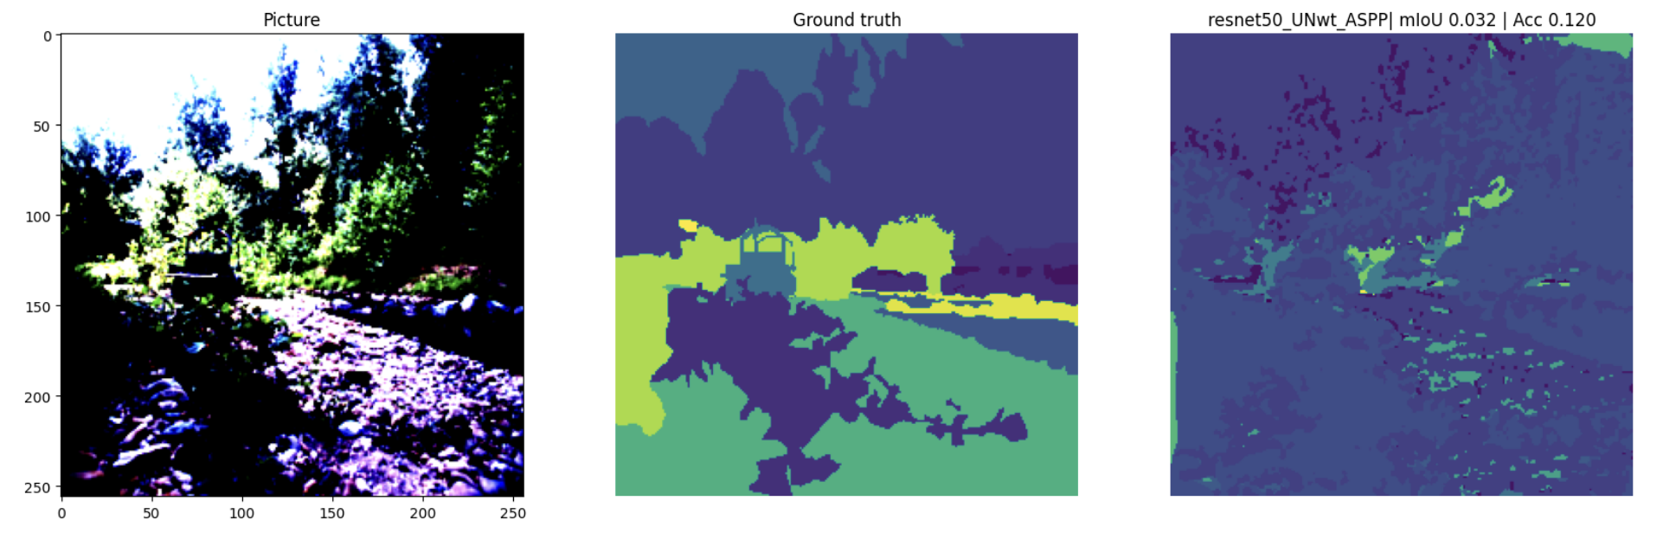
Results - ASPP Modules
Presenter: Man Ching
Discussion:
The model was able to learn contextual information well, but lacks in actual class identification
Improvement from baseline model which was only able to make binary classifications

Slide 23
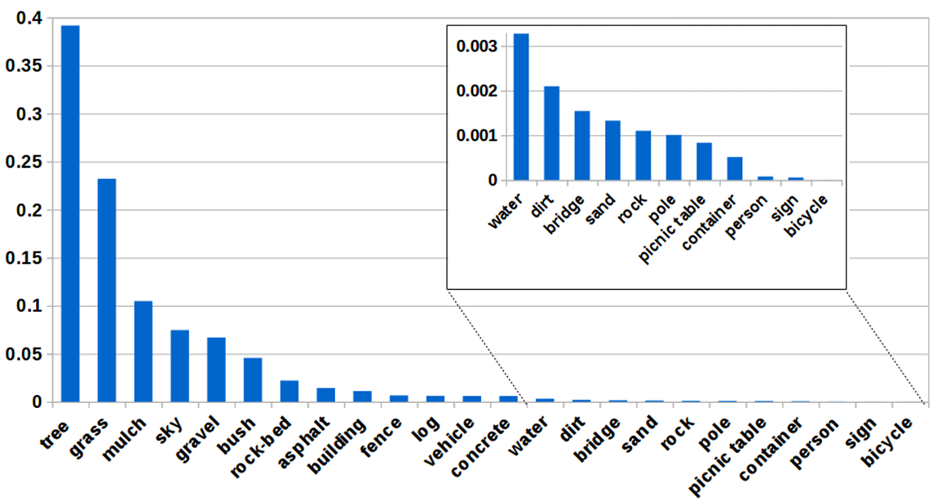
Data Augmentation - Motivation
Presenter: Aryan Wadhawan
Class Imbalance in RUGD
RUGD dataset suffers from class imbalance
This leads to biased model predictions favoring common classes
Data Augmentation to Address Imbalance
Flipping & Rotation
Synthetic Data Generation
Crop and Resize Rare Regions
CutMix / StickerMix

Slide 24
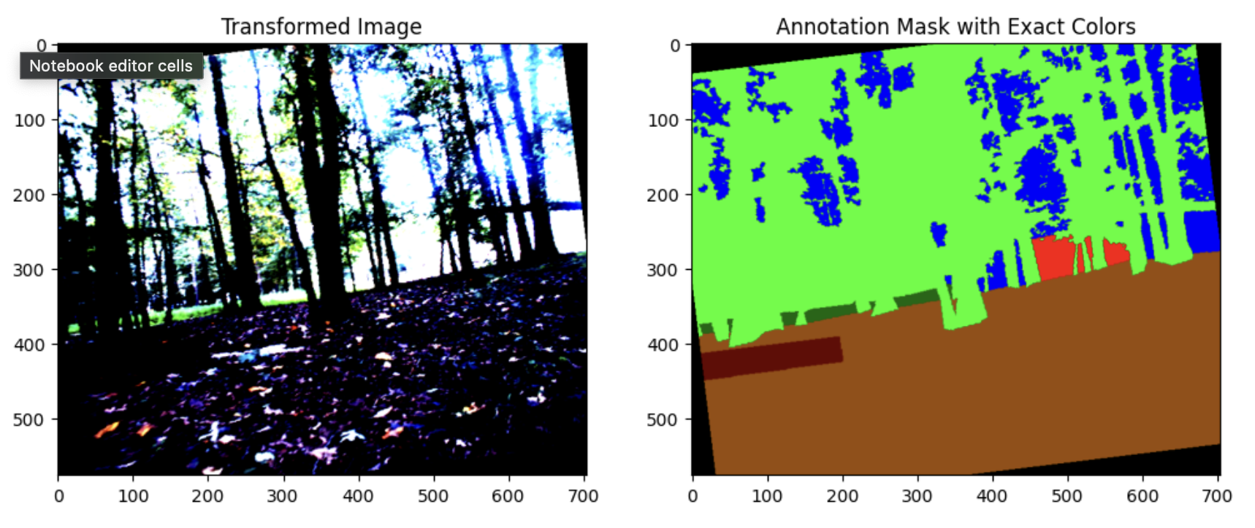
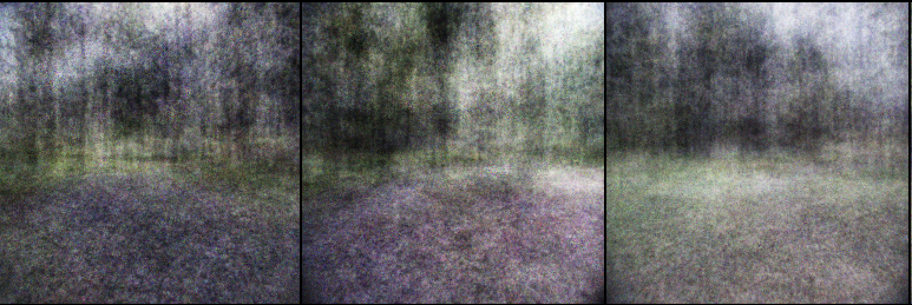
Data Augmentation - Flipping & Rotation + GANs
Presenter: Aryan Wadhawan
Rotation often creates empty edges, leading the model to focus on irrelevant areas.
GANs for data augmentation showed limited improvement due to underrepresented class data and time constraints, preventing exploration of more advanced GAN architectures.
The image and mask with 15 degrees rotation
A subset of GAN output from complete dataset

Slide 25
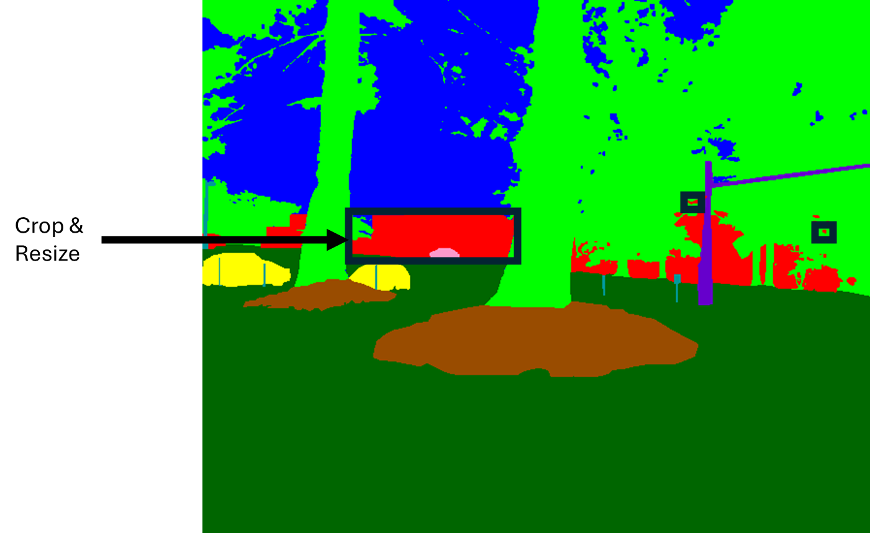
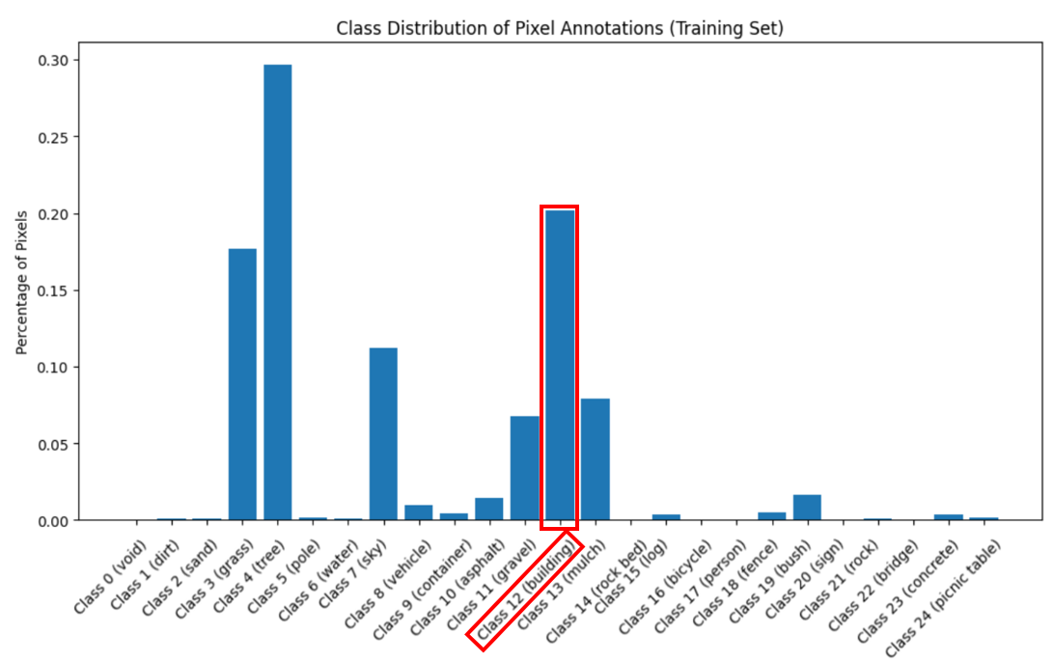
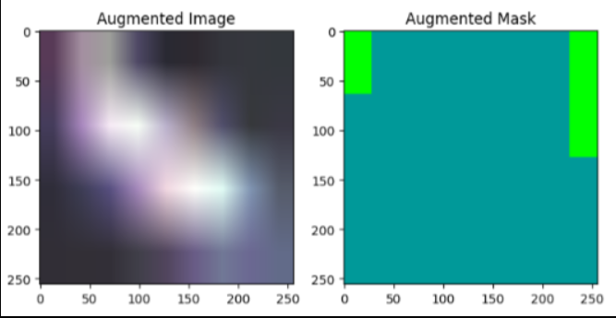
Data Augmentation - Cropping and Resizing
Presenter: Jonas Macken
Locate connected regions of rare classes
Create bounding box capturing region
Crop image and resize to full-size
Add re-sized image to training set
Images became too distorted, model learned bad features

Slide 26
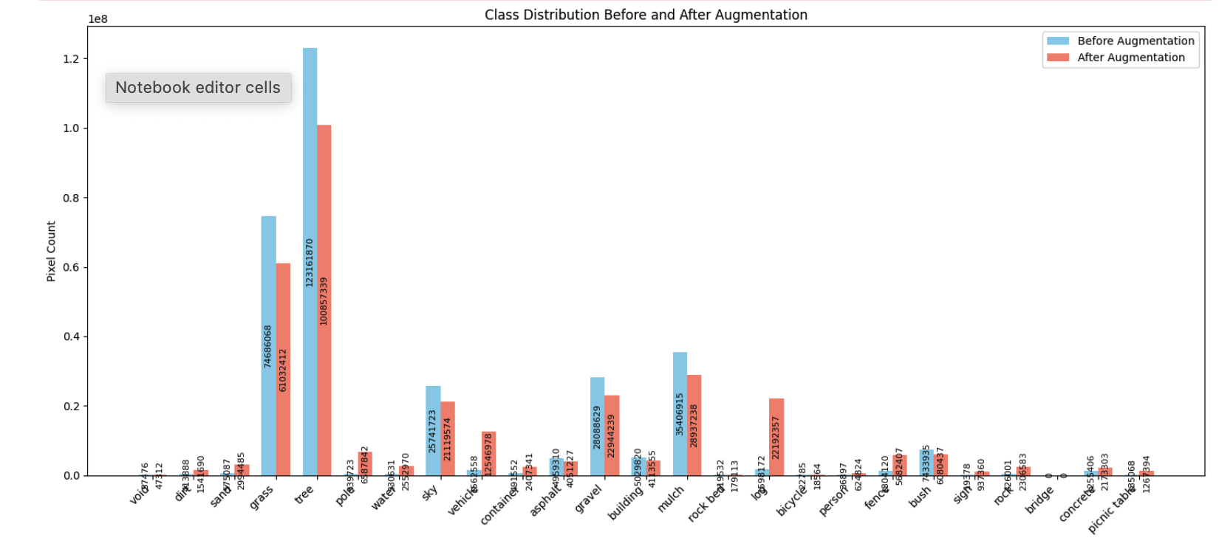
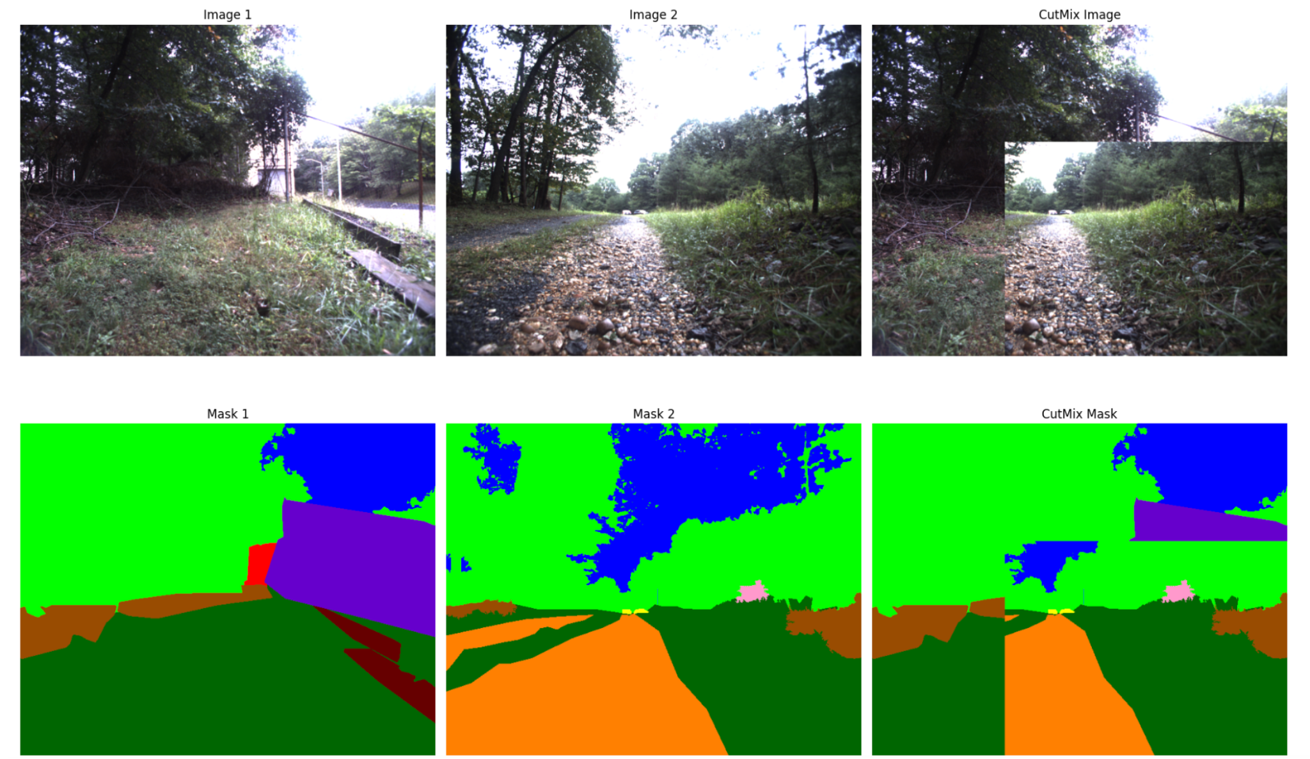
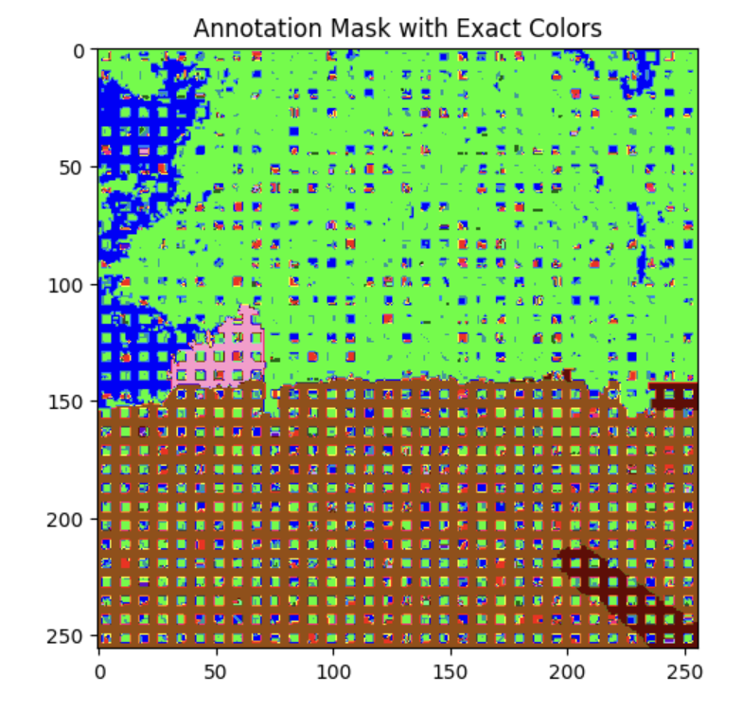
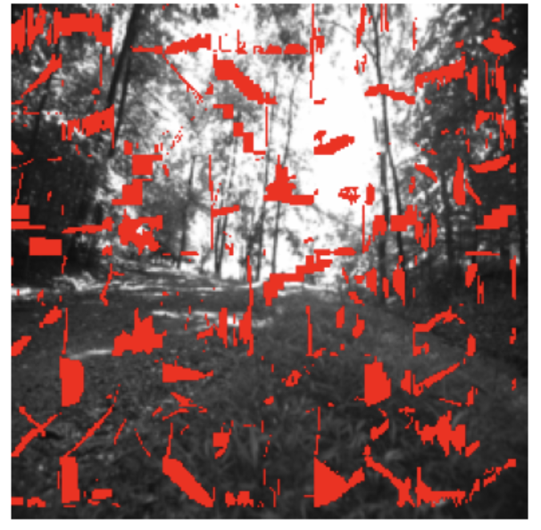
Data Augmentation - CutMix
Presenter: Zirui Wang
A method to balance the distribution of datasets through a mixed image approach

Slide 27
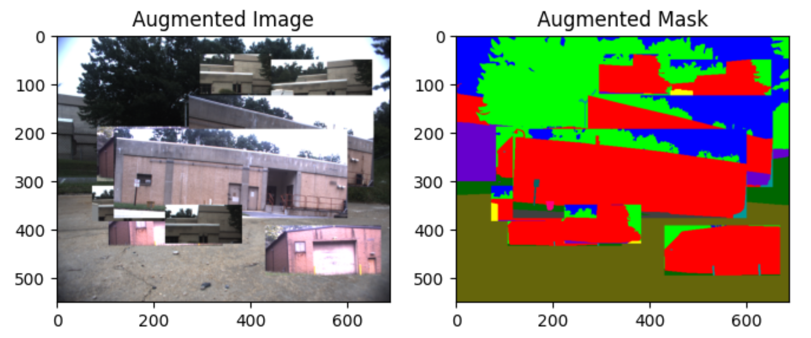
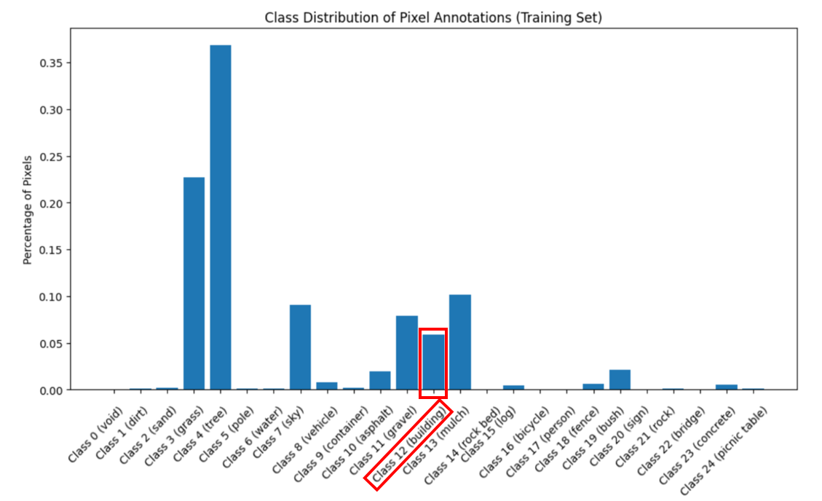
Data Augmentation - StickerMix
Presenter: Jonas Macken
A novel extension of CutMix for balancing class distribution
Class 12 (Building)
% of Total Pixels | IoU (%) | Accuracy (%)
~5 | 10.83 | 18.65
~20 | 21.60 | 26.56

Slide 28
Class-Aware Loss Weighting
Presenter: Dimas Anugerah
Use of weights based on training annotations class inverse frequency in the loss function
 | Pixel Accuracy | Mean Pixel Accuracy | Mean IoU | Delta
Baseline | 61.13% | 24.37% | 9.26%
Inverse Weighting | 64.26% | 20.93% | 10% | +0.43%
Recall Loss | 63.69% | 22.38% | 9.57% | +0.88%
Logit Inverse Weighting | 63.48% | 23.79% | 10.02% | +2.53%
Logit Inverse Weight Formula: log(1 + (total pixels / class pixel count))

Slide 29
Optimisation Strategies for Final Model:
Presenter: Zirui Wang
Optimisation Method | Improved Overall Performance?
Hyperparameter Tuning | Yes
ASPP Modules | Yes
Class-Aware Loss Weighting | Yes
Data Augmentation - Flipping / Rotations | No
Data Augmentation - GANs | No
Data Augmentation - Cropping & Resizing | No
Data Augmentation - CutMix / StickerMix | No
Use optimised hyper parameters:
Learning rate: 0.002
Batch number: 10
Momentum: 0.7
Weight decay: 0.003
Applied onto Unet baseline model

Slide 30
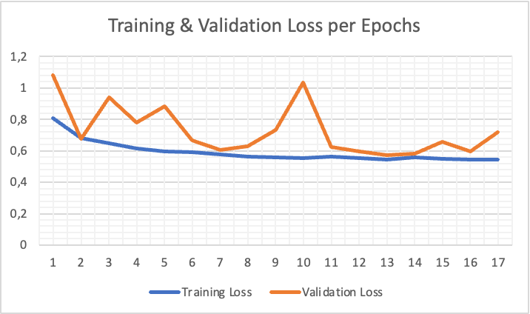
Final Model Performance
Presenter: Zirui Wang
Hyper parameters needs to be tuned for this specific model
Interactions of each individual modules are not fully investigated
Less overfitting and Mean Pixel Accuracy improved
Models | Mean IOU (%) |  | Pixel Accuracy (%) |  | Mean Pixel Accuracy (%)
Baseline | 14.65 |  | 73.81 |  | 17.87
Final model | 10.47 |  | 66.5% |  | 23.05

Slide 31
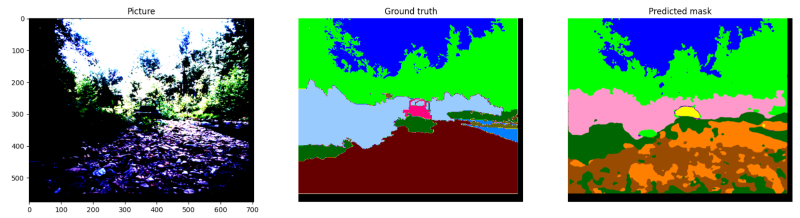
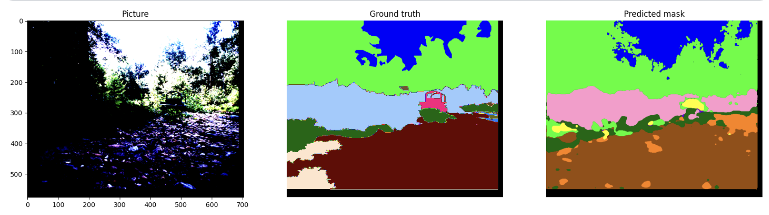
Final Model Mask Predictions
Presenter: Man Ching

Slide 32
Discussion
Presenter: Aryan + Jonas
Contributions and Novelty
Improvements to overall performance of baselines through:
Hyperparameter tuning
Architecture enhancements (ASPP modules)
Class-aware loss weighting
While combining these methods slightly reduced overall accuracy, individually these boosted baseline performance
In-depth exploration of various data-augmentation techniques, highlighting their limitations in unstructured environment tasks
StickerMix:
Novel solution to improving class-specific performance in unstructured environments
Easily adaptable to fine-tune models for environments with a high prevalence of certain classes
Potential for further development - e.g., automated class balancing with StickerMix to address class imbalances dynamically

Slide 33
Conclusion
Presenter: Dimas Anugerah
Limitation for Future Works
GPU access limitations
Comparing methods on downsampled images and less epochs
Future Works:
Use pixel count statistics to determine how many stickers of each class to paste and create a flatter class distribution (StickerMix)
Learnable GAN
Explore poly learning rate in training

Slide 34

This Photo by Unknown Author is licensed under CC BY-SA

